Slide 1
Marvel Comics API 100 COMICS
Analysis of the last 100 publications in 2023

Slide 2
Content presentation
01
02
03
04
Overview
Technical
Development
Data Analysis
Interpretation
Potential
Improvements

Slide 3
01
Overview

Slide 4

Overview
The Marvel Comics API 100 Comics Project came about after stumbling upon the incredible RESTful API that Marvel makes available to any curious individual. In addition to containing all the data recorded by the publisher about its entire range of publications (characters, formats, series, events, creators...), the API itself is a marvel in terms of how it's structured and documented.
Intuitive in its use and appealing due to its content, it attracted me enough to embark on my first foray into data-mining.
In this project, I aim to deploy an analysis of the last 100 comics published by Marvel Comics in the year 2023. I try to answer several questions that I had before starting the work:
What are the characters that appear the most?
What are the most published formats?
Who are the involved creators and which ones are the most prolific?
What is the direct relationship between the price of a format and the number of pages it contains?

Slide 5
02
Technical
Development

Slide 6

Project’s Methodology
Steps followed throughout the work
RESTful API use | Understanding the documentation, use of requests libraries, data extraction arrays/dictionaries
Cleaning data process | Data cleaning and standardization. Formatting of raw information for later use
Grouping/Aggregation data | Grouping into specific DataFrames for data comprehension. Aggregation operations for interpreting numerical data
Visual understanding | Final representation in statistical graphic charts to visually understand the obtained results

Slide 7
03
Data Analysis Interpretation

Slide 8
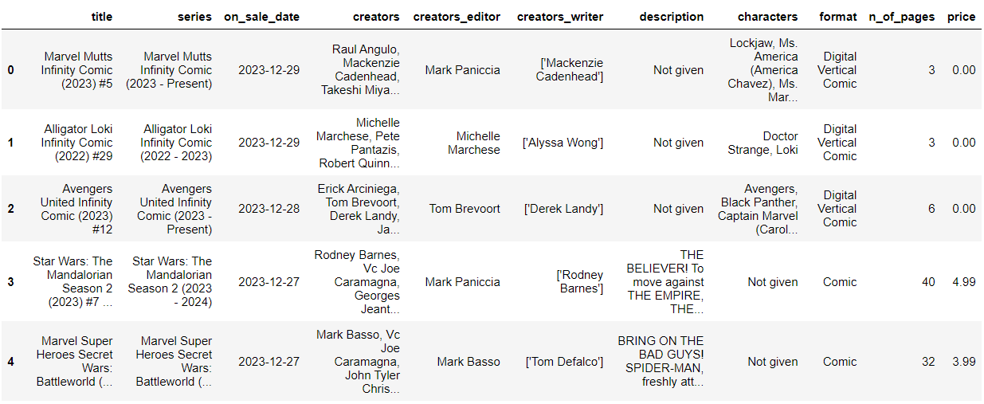
DataFrame Sneak Peak
DataFrame Sample
A glimpse at the data after data mining, cleaning and formatting the information obtained from the API

Slide 9

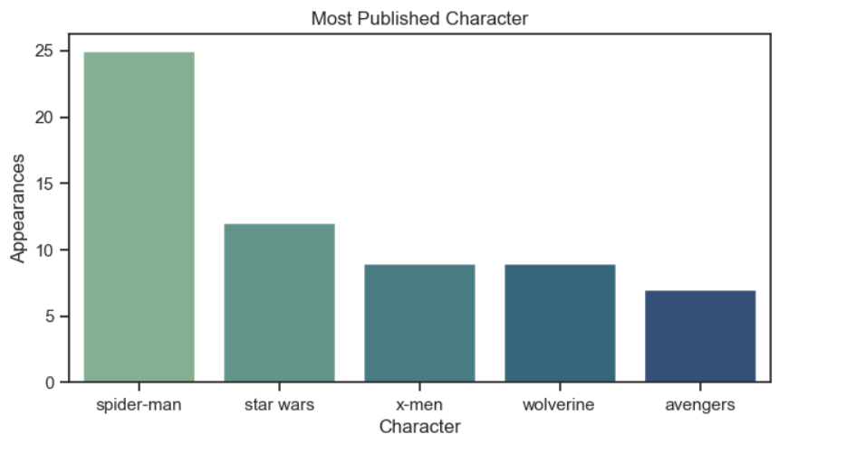
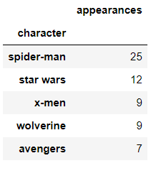
Most Published Character
Top 5 appearances in publications
This top 5 reflects the character (or theme) that appear most in the publications of the dataframe. From the top 5 onwards the appearances are much less numerous, reflecting the great variety of main characters in other comics

Slide 10
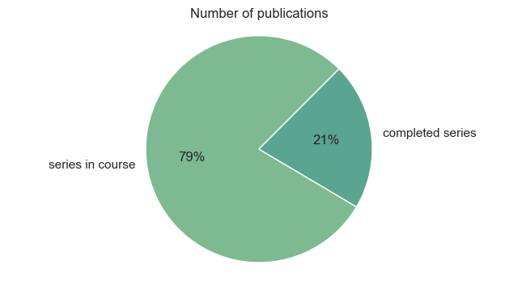
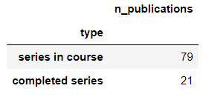
Series in Course
Percentage of Series Status
This pie-chart helps us visualize the trend for continuous publications of open series compared to the close series and one-shots

Slide 11
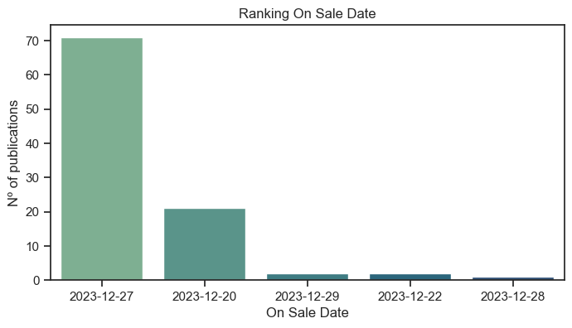
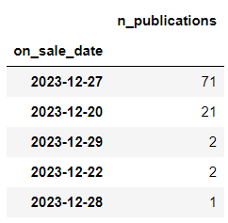
On Sale Date
Ranking On sale Date
The last 100 comics of 2023 are published between December 20th and 29th. As we can see, the 27th followed by 23th stands out as busiest days

Slide 12

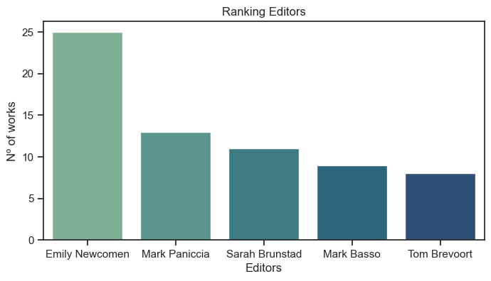
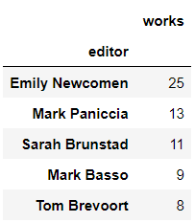
Ranking Editors
Top 5 editors per number of works
The first editor in the ranking stands out in activity above the second in the chart. After the top 5, the appearances are reduced to almost an editor relationship per single publication

Slide 13

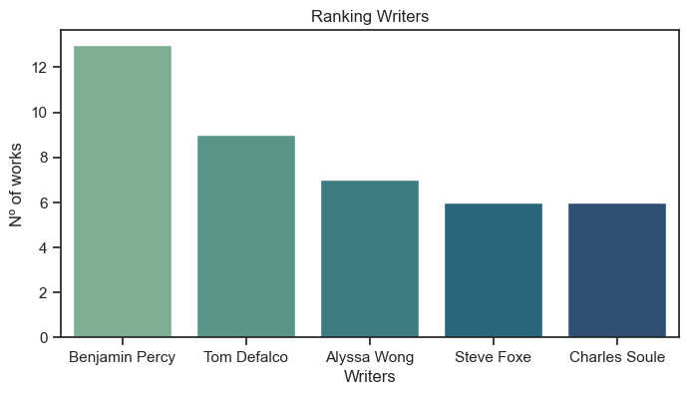
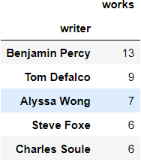
Ranking Writers
Top 5 writers per number of works
In this chart, the most prolific writer is no so far from those next at the top. It stands out that the works are more numerous throughout the data collected, in contrast to the editor’s activity

Slide 14
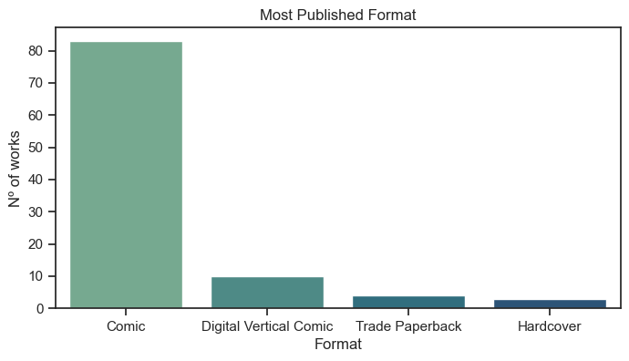
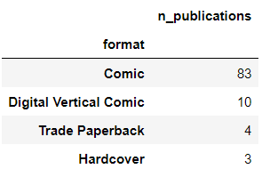
Most Published Format
Formats availables
It is clearly seen how the comic predominates compared to the other three types. It must also be understood that both “Trade Paperback” and “Hardcover” are special formats that are not so recurring. And “Digital Vertical Comic” is an online subscription launched recently

Slide 15
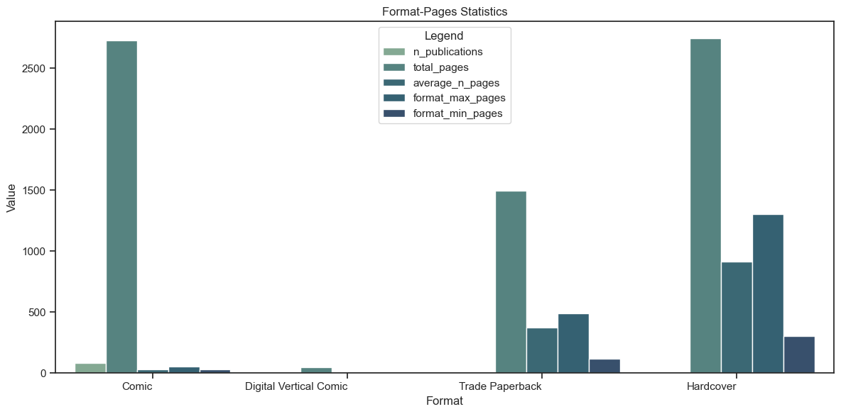
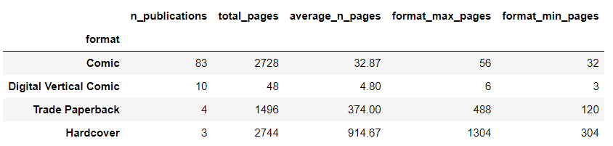
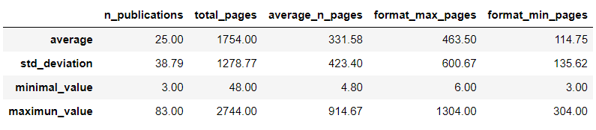
Format-Pages Statistics
Relation of each Format per number of Pages
The last 100 comics of 2023 are published between December 20th and 29th. As we can see, the 27th followed by 23th stands out as busiest days

Slide 16
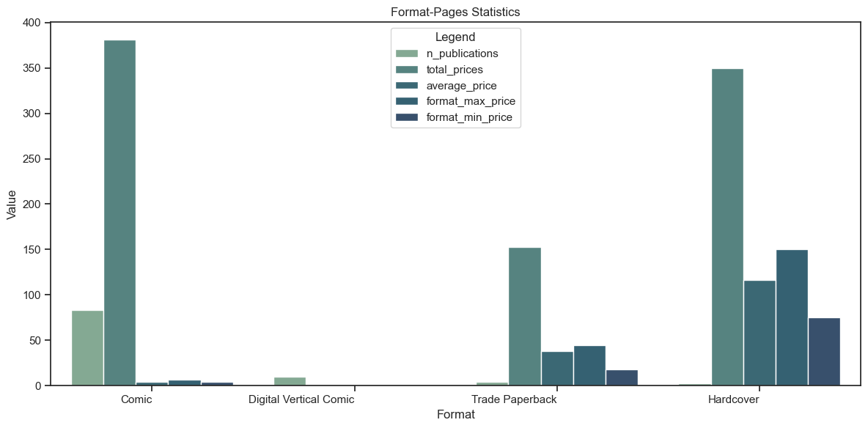
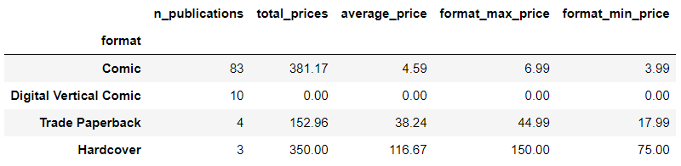
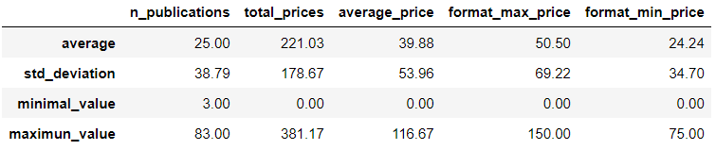
Format-Prices Statistics
Relation of each Format per Publication price
The last 100 comics of 2023 are published between December 20th and 29th. As we can see, the 27th followed by 23th stands out as busiest days

Slide 17
Thanks

